Slide 1








Ethereum

Slide 2
Blockchain

Slide 3



Slide 4


Block
DATA

Slide 5

Block
Block
Blockchain
DATA
Hash
Hash
DATA

Slide 6


Block
Block
DATA
Hash
DATA
Hash
Hash
Forgery

Slide 7


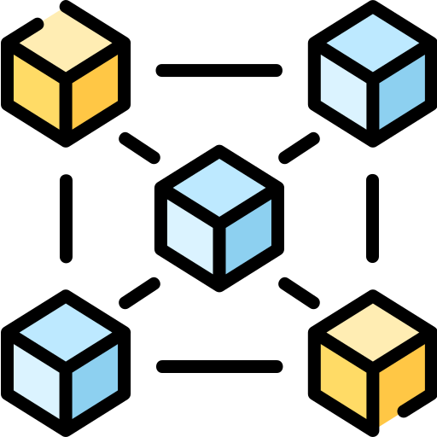


Blockchain

Slide 8



Blockchain

Slide 9



In 2013
Ethereum
Mr. Vitalik Buterin

Slide 10







Slide 11

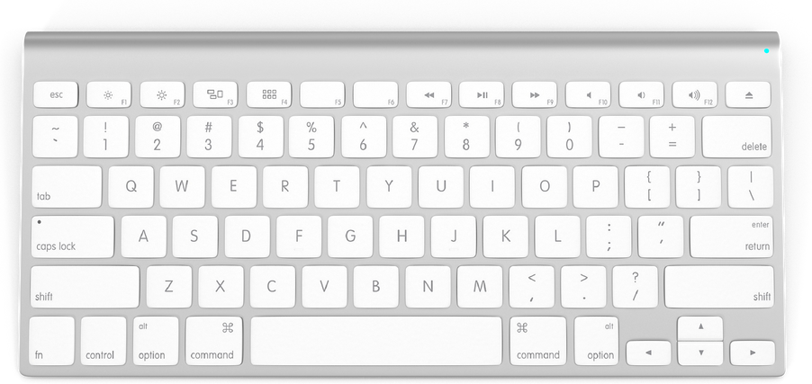


Run on
Ethereum

Slide 12
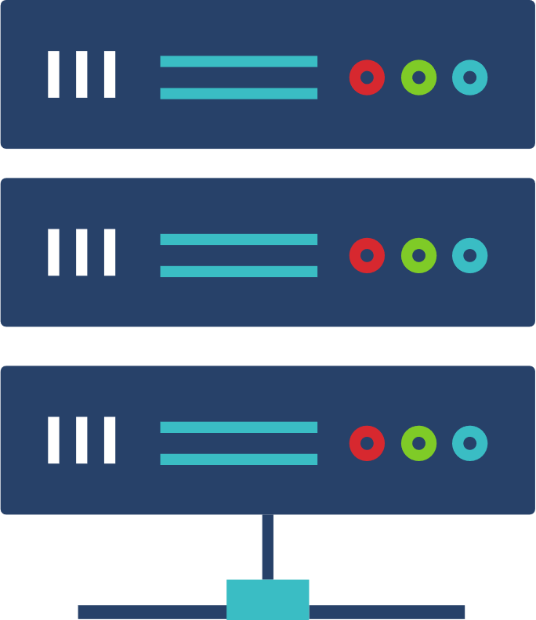


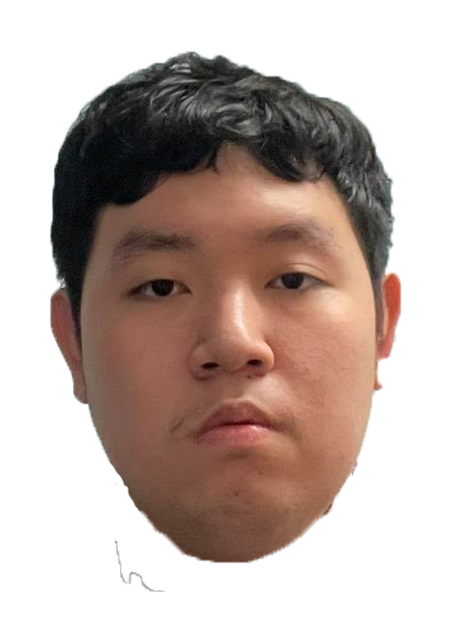
Install on
Server Machine

Slide 13


Crash
Attacked

Slide 14


Not
Working

Slide 15



DApp
Decentralized Application

Slide 16

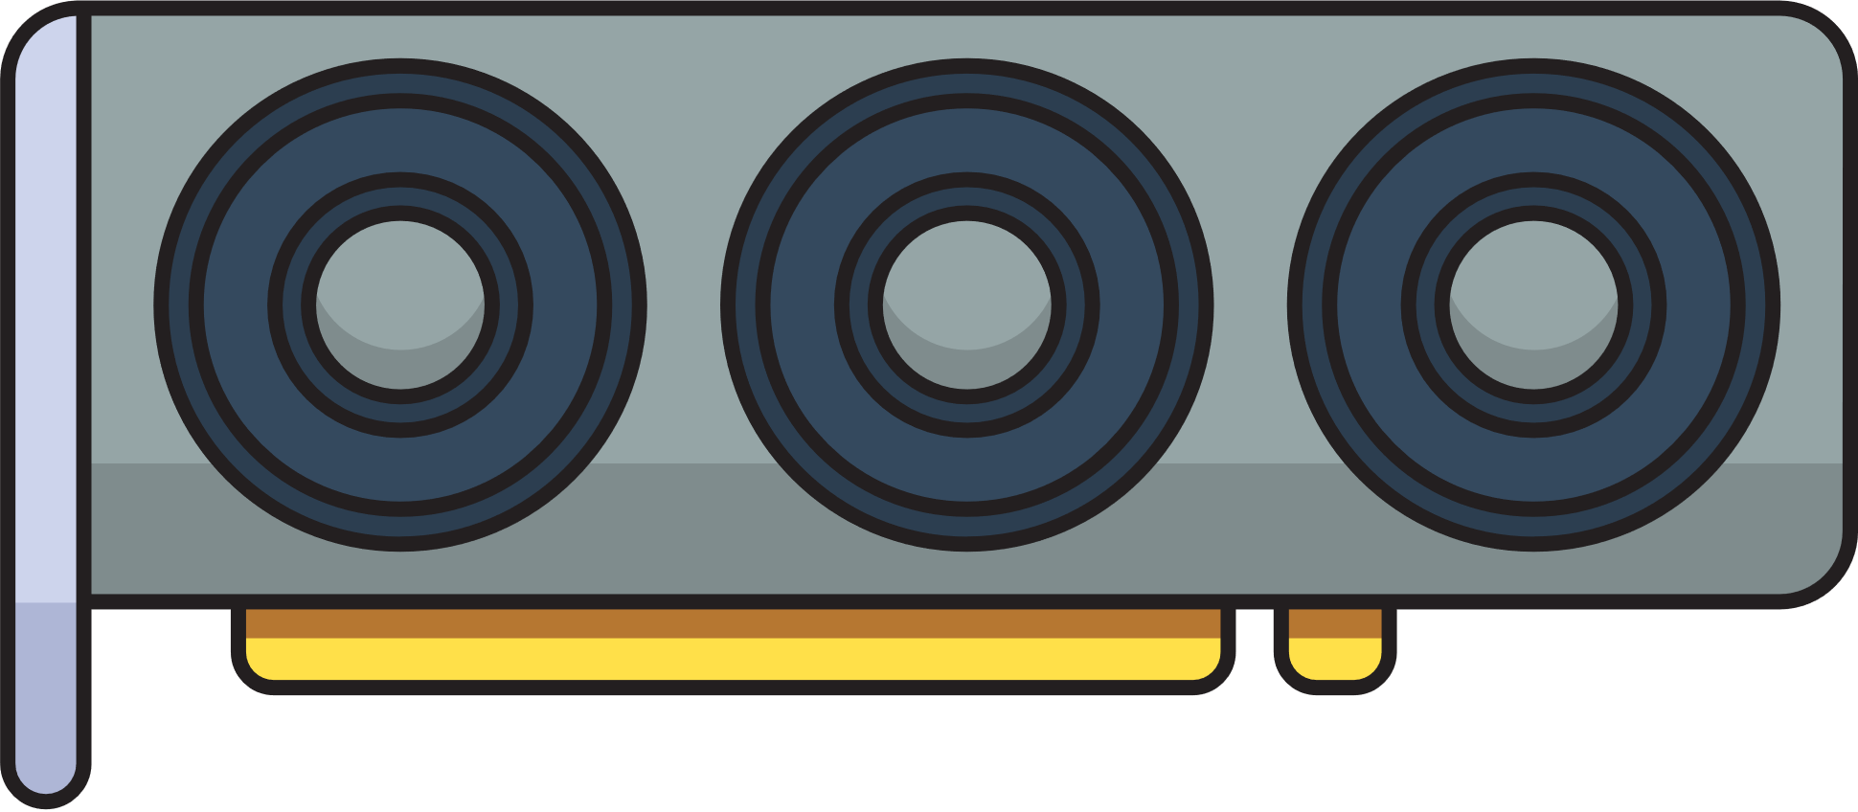



Validator

Slide 17



112,000
Baht
108,000
115,000
114,000
113,000
111,000
110,000
109,000

Slide 18

Open Source

Slide 19



Finance
Marketplace
Game

Slide 20

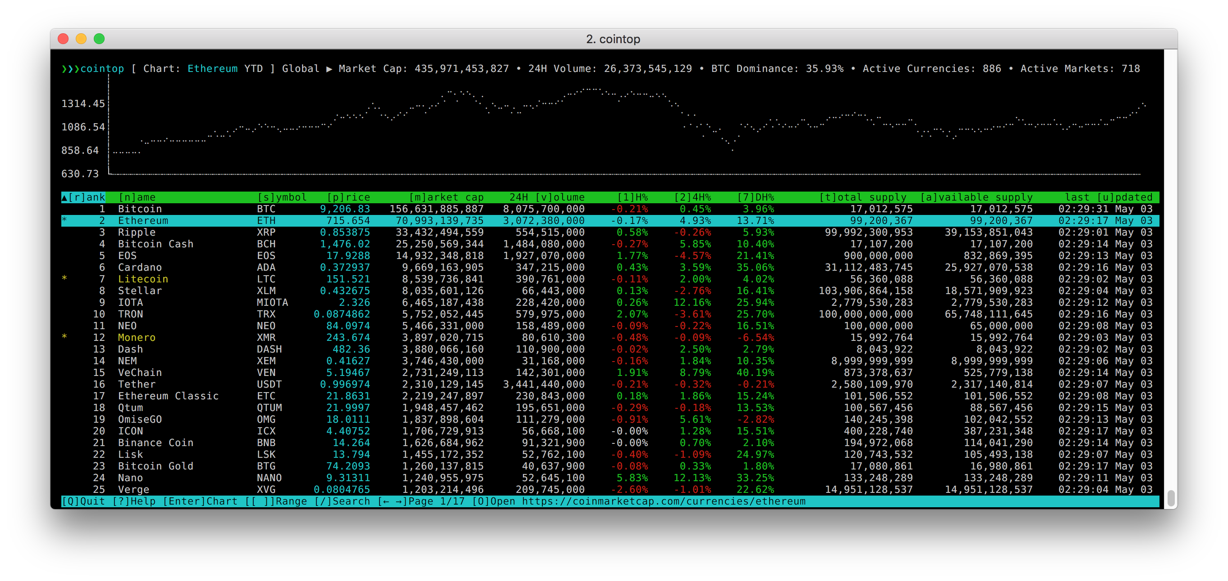

COINTOP

Slide 21



Slide 22



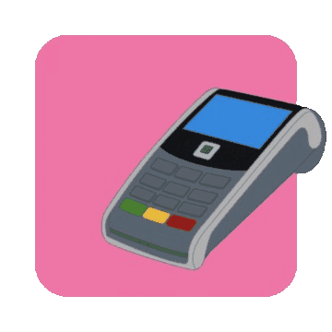

Slide 23
CAST
Kittipod Rungruang
Supporter
Nattanan Amornlertwit
Quality Assurance
Klayuth Krongkaew
Planner
Warisara Rittisorn
Developer
Thanatip Boonnat
Support Manager
Natdanai Intasorn
Development Manager
Benjapon Kasikitwasuntara
Developer
Preechaya Choosrithong
Plan Manager
Tadsawan Waeohong
Developer
Wirat Sakorn
Team Leader
Worarat Kaserm
Quality Assurance Manager

Slide 24


